Slide 1
ENFORCEMENT OF INTELLECTUAL PROPERTY IN THE DIGITAL ERA - CHALLENGES & EMERGING TRENDS
Session 3:
Cybersecurity and IP Protection
H.E Dr Kong Phallak, Secretary of State of the Ministry of Post, Telecommunications / Member of the National Committee for IP of Cambodia
Mr Shigeru Inaba, Secretary General APPA / Partner of Sayagata IP
Mr Gilbert Leong, Senior Partner, Dentons Rodyk & Davidson LLP
Mr Chew Phye Keat, Partner, Raja, Darryl & Loh (as facilitator)

Slide 2
What is this session about
We will explore:
the nature of cyber risks and the landscape of cybersecurity from a global and national perspective
how IP is impacted by cyber risks and the role of cybersecurity in protecting IP and how IP plays a role in enhancing cybersecurity
the governmental role in introducing and regulating cybersecurity measures and the challenges in ensuring a safe and effective cybersecurity system – the Cambodian experience

Slide 3
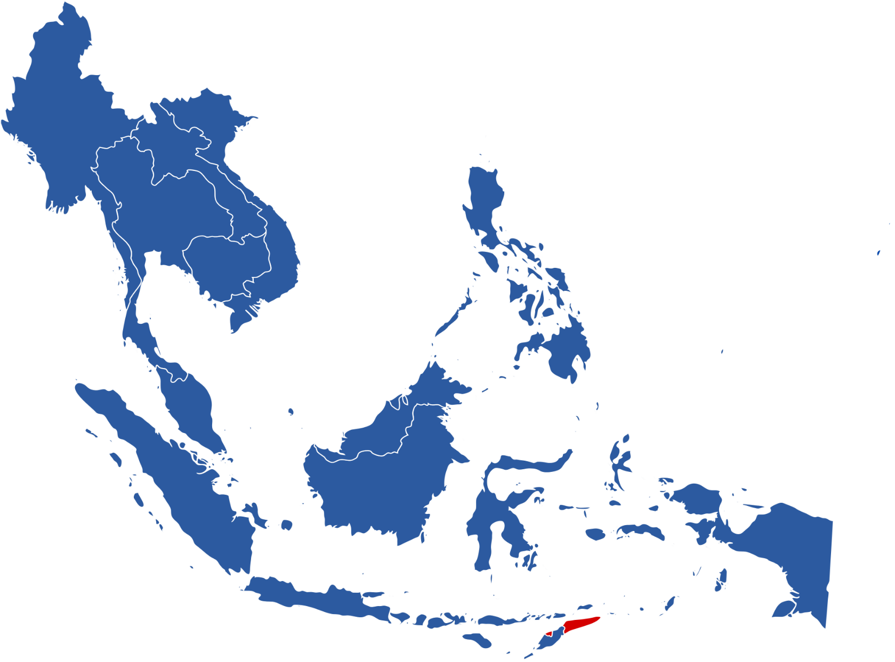
Historical Snapshot of data breaches in ASEAN
Thailand
2021 – Personal Data of 10,095 patients of Phetchabun Hospital breached
Thailand
2018 – Personal data of 123,000 customers of two major commercial banks, Kasikornbank and Krung Thai Bank, were stolen
Thailand
2021 – 17 GB of Identity card information was leaked from cryptocurrency platform, Pi Network
The Philippines
2021 – 345,000 sensitive documents have been exposed to the public - The Office of the Solicitor General of the Philippines
Thailand
2021 – More than 106 million travellers to Thailand had their personal details exposed online.
Vietnam
2016 – Personal data
of 410,000 customers of Vietnam Airlines
compromised by a
cyberattack
Malaysia
2018 – Bank Negara Malaysia, the Central Bank of Malaysia suffered a cyberattack, but no funds were stolen
Cambodia
2021 – Data on discussions between China and Cambodia was stolen from Cambodia’s Ministry of Foreign Affairs
The Philippines
2021 – 3.3 million data records of users of Fintech company, Cashalo, were sold.
Singapore
2021 - Accellion – nearly 130,000 Singtel customers’ personal information, including NRIC details, stolen in data breach.
Singapore
2019 – Personal
data of 800,000 blood donors leaked online
by HSA’s vendor
Singapore
2018 – SingHealth APT attacker stole
1.5 million patients’ data
Indonesia
2020 – E-commerce Tokopedia – the personal data from 91 million accounts were breached and put on the Dark Web

Slide 4
Threats – External and Internal
Cyber-attacks
Ransomware
Vendors
Employees

Slide 5
Ransomware Attacks
Ransomware
Malware that employs encryption to hold a victim’s information at ransom.
Prevents the user or organisation from accessing files, databases or applications.
In Singapore, ransomware incidents reported to Singapore Cyber Emergency Response Team remained high at 132 cases in 2022. Ransomware groups are also turning their attention to cloud services and infrastructure as more organizations are moving their virtual assets and data to the cloud.
There has also been a growing prevalence of malware-free ransomware attacks – such attacks do not involve infecting the victim’s system with malware to encrypt their data to hold it hostage, but instead focus on directly exfiltrating their data (particularly those of a sensitive nature) to coerce victims into paying for fear of it being leaked publicly.
According to CrowdStrike, such attacks accounted for 71% of its detection in 2022, as compared to 62% the year before.

Slide 6
Cyber-Attacks - DDoS
Distributed denial-of-service (DDoS) attacks usually involves a threat actor attempting to prevent legitimate users from accessing information or services online.
The most common and obvious type of DoS attack occurs when an attacker “floods” a network with information. For instance, in a DDoS attack, an attacker takes unauthorized control of multiple computers that may be harnessed as a botnet to launch a DoS attack.

Slide 7
Cyber-Attacks - Phishing
A common technique used by threat actors to trick people (typically through emails) into divulging personal information or credentials, transferring money, or installing malware on their devices.
Phishing attempts reported to the Singapore Cyber Emergency Response Team nearly trebled to about 8,500 in 2022 from 3,100 in 2021 (an increase of 174%), with the top three spoofed sectors being banking and financial services, the government and logistics.
Banking and financial institutions are often targeted by phishing attacks as they are trusted organizations which hold sensitive and valuable information such as personal details and login credentials.
Whaling attack: attack is designed to maximize impact by focusing on senior/high-level executives and leadership figures within an organization. May be combined with spear-phishing.
Data compiled from Singapore Cyber Landscape 2019, 2020, 2021, 2022 published by CSA.

Slide 8
Vendors
Vendor security vulnerabilities may in turn pose a risk to organisation’s systems and networks, especially if:
The vendor processes, collects, uses, transmits, or stores data belonging to organisation or its customers.
Organisation relies on and makes use of the vendor’s platform, software, servers or systems as part of its business operations.
The vendor does not have proper protocols, standards and practices in place that govern the access and utilization of organisation’s and/or its customer’s data and information.
The vendor does not conduct regular audits, certifications, penetration testing to evaluate and update their security controls.

Slide 9
Employees - Remote Working – Cybersecurity risks
Personal devices used for work
Use of Work devices by family members
Unsecured network connections
Lack of encryption
Email / phishing scams
Image source: Hugo.team
Increase use of cloud storage and potential for access misconfigurations
Weak password policy / enforcement
Maintaining
Confidentiality

Slide 10
Employees - Remote Working – Cybersecurity risks
Source: Forbes
Source: Malwarebytes Labs
Source: Forbes

Slide 11
Employees – Insider Threats – Cybersecurity risks
Insider threats are cybersecurity threats that originate with authorized users, such as employees, contractors and business partners, who intentionally or accidentally misuse their legitimate access, or have their accounts hijacked by cybercriminals (From IBM website).
Malicious insiders have a distinct advantage over external cyber attackers due to their access to specific data and their familiarity with the organization's systems.
Insider threats are the cause of most IP theft.
Traditional cybersecurity measures often focus on external threats, leaving the organization vulnerable to insider threats.
The unwitting employee who leaks.

Slide 12
Enhancing Cybersecurity
Technical measures
Non-technical measures
Employee training
Employee policies
Cybersecurity insurance
Vendor controls

Slide 13
Characteristics of IP in connection with DataLeaks
Intangibility
IP is an intangible asset that can be possessed as digital data, which can be easily accessed and copied without adequate safeguards.
Openness (Traditional IP rights)
The acquisition of IP rights is inherently accompanied by the disclosure of those rights. Published IP information, typically patent publications, can be easily accessed and copied by anyone. As far as published IP rights are concerned, data leaks do not result in IP theft; however, data leaks involving copyrighted material may constitute copyright infringement. Published IP rights (patents, designs, trademarks, copyrights) are generally robust against data leaks.
Confidentiality (Trade secrets)
Who owns what trade secrets is a black box. Trade secrets lose their value when they are disclosed. Trade secrets are the most vulnerable to IP theft and data leaks.

Slide 14
Invention and Data Leaks
Invented
Filing
Published
Registered
Most vulnerable
(Invention disclosure)
Less Vulnerable
(Unpublished patent document)
Least vulnerable
(Published patent document)
Data leaks
Data leaks
Data leaks
Risk of theft or losing novelty
No negative effect on a pending application
Nothing happens

Slide 15
Characteristics of IP in connection with Online IP Infringement
Principle of Territoriality
The principle of territoriality in intellectual property law holds that intellectual property rights are limited to the territory of the country where they have been granted.
Cyberspace
The world is going digital, and cyberspace is becoming a major business platform.
Where is the location of cyberspace?
Can the locations of hardware devices that constitute cyberspace be regarded as the location of cyberspace?
Patent claims define the hardware elements of a system, so the locations of hardware devices can serve as clues to determine patent infringement, although extraterritoriality is another issue.
What about copyright infringement and trademark infringement that occur in cyberspace?

Slide 16
Limit of IP Law in connection with Data Breach
IP laws cannot protect IP data from data breach.
What IP laws can do is limited once data breach occurs.
Laws have very limited ability to recover the value of stolen data that is inherently confidential and subsequently published.
For instance, in Japan, the Civil Code and the Unfair Competition Prevention Act play a very limited role in addressing issues related to stolen data.
Filing a damage claim for a data breach against cybercriminals, such as ransomware gangs, is exceedingly challenging.

Slide 17
Rising Threats of Cyberattack - Law firms Not Exception
According to articles posted on the website of The Law Society of England and Wales,
Cyber attacks on law firms jumped by 77% over the past year.
https://www.lawgazette.co.uk/news/cyber-attacks-on-law-firms-jump-by-77/5120668.article
65% of firms have been a victim of a cyber incident, but despite the need to protect ourselves, 35% of firms still do not have a cyber mitigation plan in place.
https://www.lawsociety.org.uk/topics/blogs/are-you-the-65-percent-or-the-35-per-cent-65-percent-of-law-firms-cyber-attack-victim

Slide 18
Client Valuable Assets at risk - IP firm vulnerabilities
IP firm
Losses
of
Client’s assets;
Management time;
Trust and reputation;
Financial; and
Clients
Client Valuable Assets
Unpublished IP data;
Confidential information;
Privileged communications;
, etc.
Data Breaches
Notes:
Soft target

Slide 19
Role of Cybersecurity in connection with IP Protection
Unpublished IP data is vulnerable to
external and internal cyber threats.
IP laws cannot protect IP data from leaks and theft. What IP laws can do is limited once data breaches or theft occur. This is where cybersecurity comes into play.
Cybersecurity plays a critical role in safeguarding
an IP asset in the digital age

Slide 20
Role of Cybersecurity in connection with Data Breaches
Intellectual Property
External threats
Unpublished IP Data
trade secrets such as cutting-edge technology information and manufacturing processes;
Unpublished patent document;
Invention disclosure information;
Unpublished design, trademark and art works;
Unpublished Technical/scientific data;
Other confidential data, etc.
Cybersecurity Measures
Internal threats
Published IP Data
Robust against data leaks

Slide 21
Intersection of IP Protection and Cybersecurity in Digital Age
Protection of IP
as intangible assets
Data Breaches
IP leaks and theft by
Cyberattacks and
Insiders(malicious or negligent)
Cybersecurity Measures
(Defense, Prevention & Mitigation)
IP Law Protection and Enforcement
(Action & Prevention)
IP Infringement in Cyberspace
Online IP Infringement including
online counterfeiting, online piracy, and cybersquatting

Slide 22
Case 1:Ransomeware Attack -Kadokawa Group-
The Kadokawa Group operates in the media and entertainment industry, including the film, publishing, and gaming sectors. It owns several subsidiaries, such as BookWalker, which sells manga, novels, and magazines from various publishers; FromSoftware, the developer of the popular video game Elden Ring; and Dwango, which runs the Niconico video-sharing platform.
https://group.kadokawa.co.jp/global/business/
Niconico is one of the largest Japanese video-sharing platforms launched in late 2006.
https://www.nicovideo.jp/
Intellectual property is one of the most important and valuable assets of Kadokawa Group.

Slide 23
Cyberattacks on Kadokawa
On the morning of June 8, 2024, Kadokawa suffered a massive cyberattack consisting of ransomware and DDoS (Distributed Denial of Service) attacks.
A ransomware gang, 'BlackSuit,' claimed responsibility for the data breaches, which affected over 250,000 people and led to the suspension of Kadokawa's website services, including the Niconico video-sharing platform.
BlackSuit threatened to publish 1.5 TB of data and began publishing a portion of the stolen data on the dark web.
The cause of the data breach remains unknown, but it is presumed that it was initiated by stealing employee account information through phishing attacks.
It is unknown whether the ransom was paid.
Kadokawa's website services and the Niconico video-sharing platform resumed on August 5.

Slide 24
Cyberattacks on Kadokawa (Cont'd)
The leaked data included contracts and legal documents, as well as personal data of all employees of its subsidiary, Dwango.
It is unknown whether the leaked data included intellectual property, such as trade secrets.
Kadokawa identified and reported cases of malicious information dissemination, where a third party shared the leaked data obtained from the dark web on social media.
Kadokawa requested the deletion of such posts and pursued information disclosure requests to identify the originators of these malicious acts and take legal action against them.
In addition to operational downtime and disruption, Kadokawa suffered financial damages as a consequence of the cyberattacks, including costs related to investigating the attacks, restoring the systems, and providing compensation associated with the incident.

Slide 25
Case 2: Data Breach by Insider
On June 15, 2023, Quan Hengdao, a senior Chinese researcher at the National Institute of Advanced Industrial Science and Technology (AIST), the largest Japanese government-funded research institute, was arrested on suspicion of violating the Unfair Competition Prevention Act. He was accused of sending the institute’s confidential data on technologies for synthesizing fluorine compounds to a Chinese chemical firm via email on April 13, 2018.
The firm filed a Chinese patent application for the synthesis of fluorine compounds approximately one week after receiving the email and obtained the patent in June 2020. Quan Hengdao is listed as one of the inventors. It is suspected that the leaked data was used in drafting the patent application.

Slide 26
Case 3: : Site-blocking and Online Copyright Infringement -Background of Pirate manga website-
Addressing IP infringements in cyberspace could broadly fall within the scope of cybersecurity in connection with IP Protection.
There have been a number of pirate manga websites, where both the hardware devices hosting the sites and the actual operators are unknown or located outside Japan.
It is difficult to enforce copyrights against the operators of such pirate sites.
CODA (Content Overseas Distribution Association), an organization formed at the request of the Japanese government in 2002, has been urging site operators to shut down the pirate sites, but most of them have ignored these requests.
Pirate manga websites in cyberspace pose a significant challenge to the Japanese manga industry.

Slide 27
Manga-mura (Manga Village) Case
Manga-mura was one of the largest and most popular pirate manga websites, operating from January 2016 to April 2018.
https://www.bunka.go.jp/english/policy/copyright/pdf/93890101_02.pdf
Manga-mura was created by crawling and curating pirated copies of manga from cyberspace and operated using bulletproof hosting.
Site blocking refers to the practice of preventing access to certain websites by using technical means. Site blocking can be a cybersecurity measure to protect users from malicious sites.
In 2018, the Japanese government considered website blocking, and the site was eventually blocked by major ISPs to prevent Japanese users from accessing Manga-mura. This move was controversial, as it raised questions about whether website blocking violated "the right to know" and "the secrecy of communications" under the Japanese Constitution.

Slide 28
Manga-mura Case (Cont'd)
Romi Hoshino, a Japanese-German-Israeli site operator, was arrested in Manila in July 2019 and deported to Japan.
He was sentenced to three years in prison for copyright infringement (violation of the right to make transmittable).
On April 18, 2024, he was ordered by the Tokyo District Court to pay 1.7 billion yen (around US$12 million) in damages for copyright infringements to Shogakukan, Shueisha, and Kadokawa. The judgment was finalized on July 8, 2024.
He has no intention of paying the damages.
https://www.youtube.com/shorts/wgwZ5HzOM2k
At the very least, the judgment could serve as a warning to other existing pirate manga websites.

